Slide 1
INTERNATIONAL CONFERENCE
09.06.2017
Tallink Spa & Conference Hotell, Tallinn

Slide 2
INTERNATIONAL CONFERENCE
“The challenge of intercultural education – Yesterday, today and tomorrow…”
Conference Moderator: Kristi Ockba
Conference co-moderator: Vassili Golikov

Slide 3
OPENING SESSION
Opening words by European Commission representation in Estonia
(Mr. Paavo Palk, the policy department head at Estonia's representation to the European Commission)
Anna Lindh Foundation
(Amb. Hatem Attalah, Executive Director of Anna Lindh Foundation)
Opening words by Estonian Government
(Irene Käosaar, Estonia Ministry of Education and Research)
Opening words by Hosts and Organizers
Kaidi Krimm, Business Development Director of Tallink Hotels and Irina Golikova, Trustee of SSCW)

Slide 4
Three key speeches:
"Key challenges of intercultural education and dialogue in examples of Tunisia“
- Mr. Anis Boufrikha, Head of Tunisian Network of Anna Lindh Foundation
"Importance of Intercultural education for integration process of refugees and migrants into society" - Mrs. Marju Lauristin, Professor of Tartu University, Member of European Parliament
"Key Challenges of intercultural education in the EuroMed Region“ - Mr. Miguel Silva, North-South Centre of Council of Europe;

Slide 5
"Key challenges of intercultural education and dialogue in example of Tunisia"
Anis Boufrikha, Head of Tunisian Network of Anna Lindh Foundation

Slide 6
“Importance of Intercultural education for integration process of refugees and migrants into society”
Mrs. Marju Lauristin, Professor of Tartu University, Member of European Parliament

Slide 7
"Key Challenges of intercultural education in the EuroMed Region"
Mr. Miguel Silva, North-South Centre of Council of Europe

Slide 8
11.30- 11.45 Coffee break

Slide 9
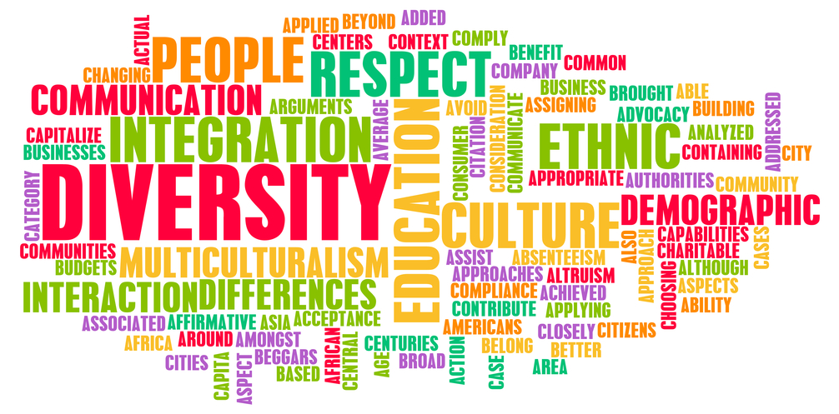
I Working session (Panel discussion)
Intercultural education and dialogue
Moderated by: Kristi Ockba, NGO MONDO and
Vassili Golikov, NGO SSCW

Slide 10
Intercultural education and dialogue
Amb. Hatem Attalah,
Executive Director of Anna Lindh Foundation

Slide 11
Intercultural education and dialogue
Mr. Mahmoud Ezzat,
Deputy Director of the Special Projects at Bibliotheca Alexandrina, Egypt

Slide 12
Intercultural education and dialogue
Mrs. Heidi Paabort,
Executive Director, Association of Estonian Open Youth Centres

Slide 13
Intercultural education and dialogue
Mr. Marwa Mahmoud, coordinator of intercultural education projects in Mondinsieme, Italy

Slide 14
Intercultural education and dialogue
Mrs. Irene Käosaar, Head of General Education Department, Estonian Ministry of Education and Research

Slide 15
QEUESTIONS?

Slide 16
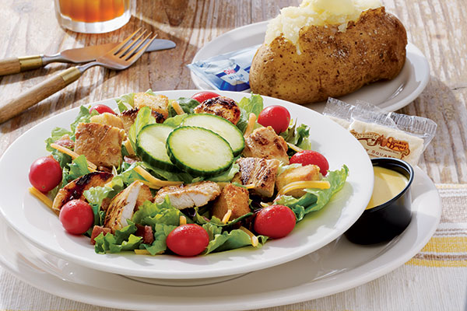
13:30 – 14.30 Lunch

Slide 17
II Working session (Panel discussion)
Citizenship and human rights in intercultural education
Moderated by: Justina Kaluinaitė, Lithuanian NGDO Platform and Zahid Mahmoud, British Council

Slide 18
Citizenship and human rights in intercultural education
Mrs. Susanne Kallanvaara, Munkebäcksgymnasiet, Göteborg, Sweden

Slide 19
Citizenship and human rights in intercultural education
Mr. Kari Käsper, Director of Estonian Human Rights Centre

Slide 20
Citizenship and human rights in intercultural education
Ms. Liis Tamman, International youth work senior specialist in Tallinn Sports and Youth Department

Slide 21
Citizenship and human rights in intercultural education
Mr. Anis Boufrikha, Head of Tunisian Network of Anna Lindh Foundation

Slide 22
Citizenship and human rights in intercultural education
Ms. Piret Hartman, Deputy secretary general of Estonian Ministry of Culture

Slide 23
QEUESTIONS?

Slide 24
WORKING GROUPS
Working group I – Implementing results and proposals from EU and Arabian countries / Room Romantica
Working group II – Best practices + case analysis from different angles / Room - Galaxy
Working group III – Moving Beyond the Extremist Narrative: Youth on the frontline” The working group will focus on the potential of the next generation of intercultural leaders to create alternative narratives to extremist discourses / Room Victoria

Slide 25
Working group I (Room Romantica)
Best practices + case analysis from different angles
Moderator: Kari Käsper
Contributors: Anis Boufrikha, Susanne Kallanvaara, Evelyn Valtin, Maire Merioja and Liis Tamman

Slide 26
Working group II (Room Galaxy)
Implementing results (Educational E-Toolkit and Web-Resource / Cooperation platform) and proposals from EU and Arabian countries.
Moderator: Sophie Khalid Contributors: Federica Trimarchi, Vassili Golikov, Mari-Liis Mäevere and Ilona Rojae etc…

Slide 27
Working group III (Room Victoria )
Working group III – Moving Beyond the Extremist Narrative: Youth on the frontline” The working group will focus on the potential of the next generation of intercultural leaders to create alternative narratives to extremist discourses
Moderator: Mahmoud Ezzat
Contributors: Marwa Mahmoud, Zahid Mahmoud and Eigo Varemäe etc…

Slide 28
Educational Guide+Web-Resource

Slide 29
eUROPEAN – ARABIAN EDUCATIONAL WEB-RESOURCE!
This is tool for every person who is interested in intercultural education, youth issues, entrepreneurship, development and cooperation.

Slide 30
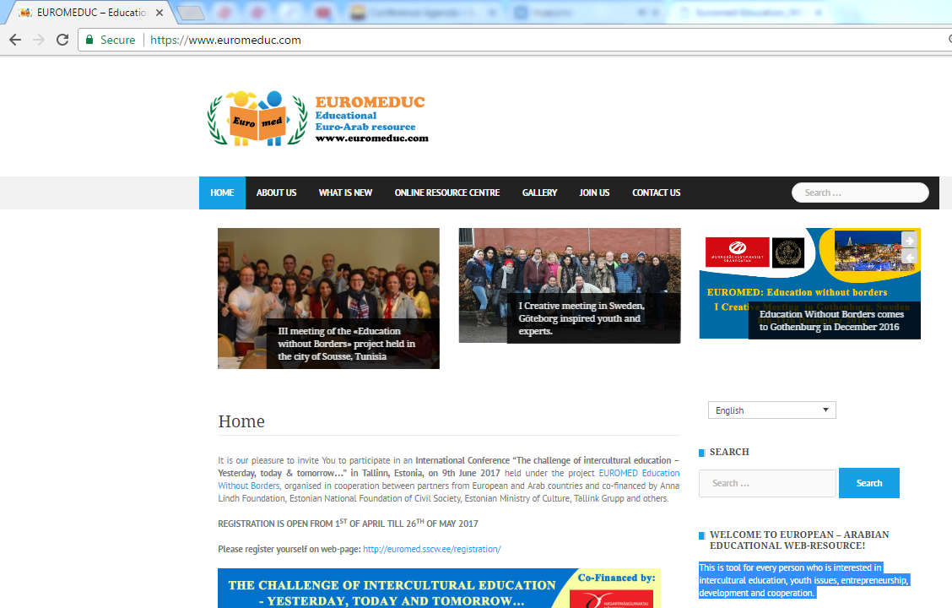
www.euromeduc.com

Slide 31
A GUIDE TO INTERCULTURAL EDUCATION
EURO-MEDITERRANEAN EDUCATION, CULTURE, YOUTH AND CIVIL SOCIETY.
Estonia, Latvia, Sweden, UK, Italy, Morocco, Tunisia and Egypt

Slide 32
CONCLUSIONS

Slide 33
AKNOWLEDGEMENT
WE WOULD LIKE TO THANK OUR PARTENRS AND SUPPORTERS
TÄNAME MEIE TOETAJAD JA KOOSTÖÖPARTNERID:

Slide 34
THANK YOU FOR YOUR PARTICIPATION! TÄNAME OSALEMISE EEST!
MTÜ SILLAMÄE LASTEKAITSE ÜHING
PEACE CHILD EESTI
Vaata rohkem: www.sscw.ee

